Slide 1
05 Regression

Slide 2
Lecture Plan
Introduction to Regression
Linear Regression (선형회귀)
Polynomial Regression (다항회귀)
Regularized Linear Regression
Ridge Regression
Lasso Regression
Elastic Net
Logistic Regression
Multinomial Logistic (Softmax Regression)

Slide 3
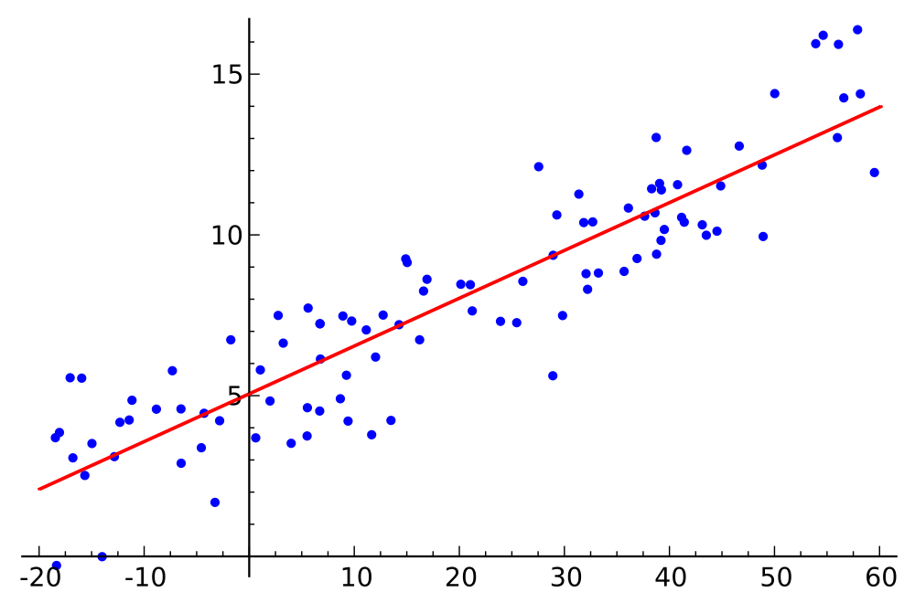
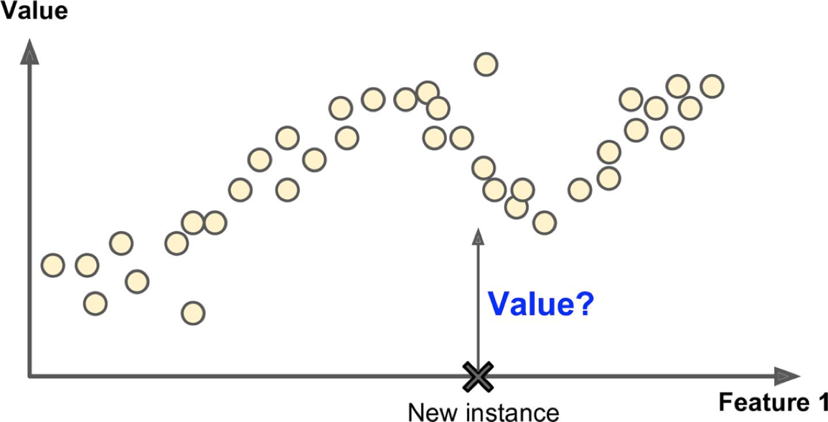
Regression Analysis
Statistics
Regression analysis is a set of statistical processes for estimating the relationships among variables.
통계학에서 회귀 분석이란, 변수들간의 관계를 추정하는 통계적 과정
Machine Learning
Regression analysis is the prediction of continuous target variables.
머신러닝의 회귀는, 연속성의 타겟 변수를 예측하는 작업
E.g., prediction of house prices
https://en.wikipedia.org/wiki/Regression_analysis

Slide 4
Linear Regression

Slide 5
Linear Regression
The goal of linear regression is to model the relationship between one or multiple features and a continuous target variable.
선형회귀의 목적은 하나 혹은 여러 개의 피쳐와 연속선상의 타겟 변수 간의 관계를 모델링 하는 것이다.
Feature: independent variable, explanatory variable
Target: dependent variable, response variable
Types
Simple linear regression (one independent variable)
Multiple linear regression (multiple independent variables) (다중 회귀 분석 ) (X1, X2 …)

Slide 6
Simple Linear Regression
The goal of simple linear regression is to model the relationship between
a single feature (explanatory variable x) and
a continuous valued target (response variable y)
Equation
𝑦 = 𝑤₀ + 𝑤₁𝑥
𝑤₀ represents the y-axis intercept. (절편)
𝑤₁ is the weight coefficient of the explanatory variable.(계수)

Slide 7
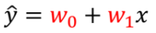
Simple Linear Regression
Goal
Learn the weights using the training dataset. (학습데이터로 기울기,Y절편 학습하는 것)
Use the weights to predict the targets of new explanatory variables.
새로운 X 데이터의 target 을 예측하기 위해 사용
Learn Predict
y
y
x
x

Slide 8
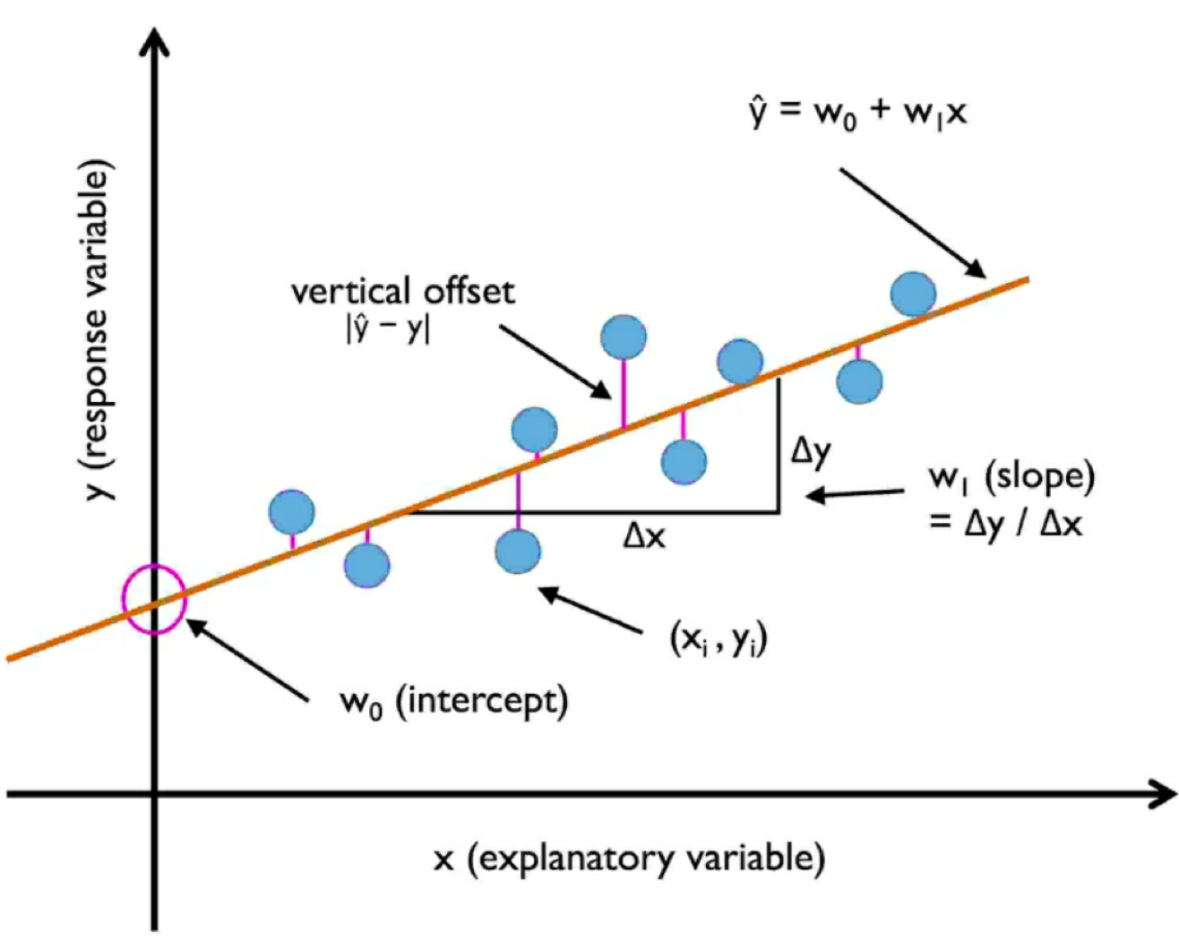
Simple Linear Regression
Linear regression is about finding the best-fitting straight line through the sample points.
가장 잘 맞는 직선을 찾는 것이다.
Regression line: the best-fitting line
Offsets (or residuals): the errors of prediction
(or 잔차) : 예측값의 에러

Slide 9
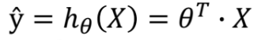
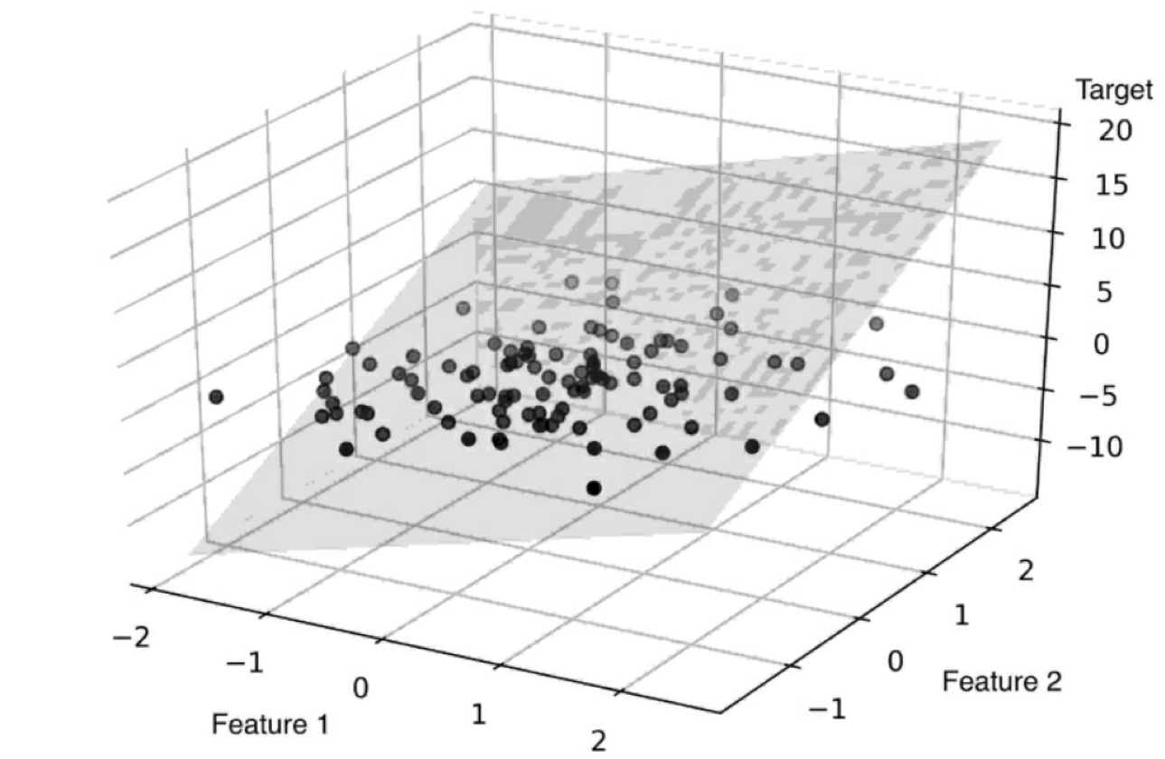
Multiple Linear Regression (다중 회귀 분석)
Linear regression with multiple explanatory variables.
Equation
ŷ = 𝑤₀𝑥₀ + 𝑤₁𝑥₁ + ⋯ + 𝑤_{𝑛}𝑥_{𝑛}
𝑤₀ represents the y-axis intercept with 𝑥₀ = 1
𝑤₁, ⋯ 𝑤_{𝑛} are the weight coefficients of the explanatory variables.
ℎ* is the hypothesis function using the model parameters -
𝜽^{𝑇} is the model’s parameter vector, containing the bias term -₀
X is the feature vector, containing 𝑥₀ to 𝑥_{𝑛}, with 𝑥₀ = 1
Example
Fitted hyperplane with two features.

Slide 10
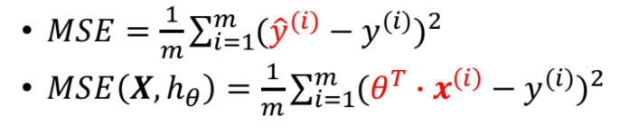
Mean Squared Error (MSE)
Training a model means setting its parameters so that the model best fits the training set.
모델 학습 : 파라미터를 셋팅하는 것 🡪 모델이 학습 데이터에 가장 잘 맞도록
A measure of how well (or poorly) the model fits the training data.
MSE란 모델이 학습데이터에 얼마나 잘 맞느냐 측정하는 값
The goal is to find the value of 𝜽 that minimizes the MSE.
목표는 MSE를 최소화 하는 𝜽 의 값을 찾는 것
Cost function

Slide 11
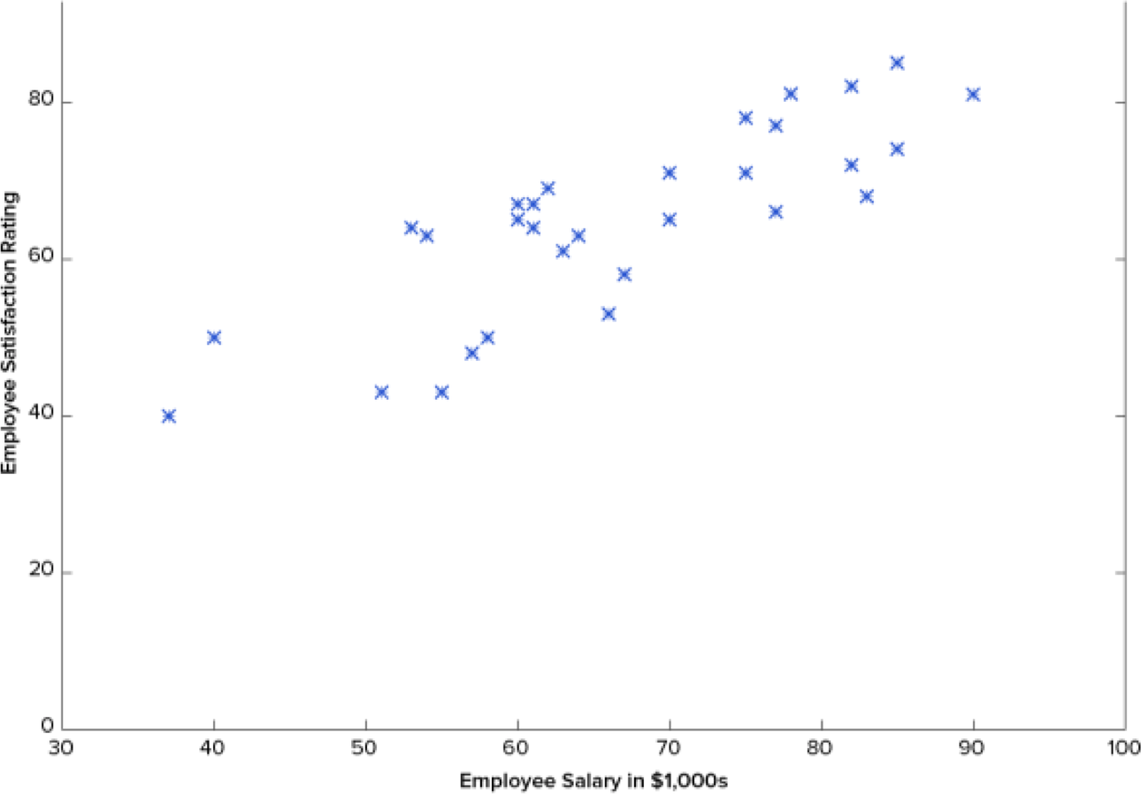
Simple Linear Regression Example
x: Employee salary
y: Employee satisfaction rating
Task
To predict an employee’s satisfaction rating based on his/her salary.
월급에 다른 만족도를 예측하는 것.
Employee | Salary | Satisfaction Rating
100 | 𝑥₁ | 𝑦₁
101 | 𝑥₂ | 𝑦₂
102 | 𝑥₃ | 𝑦₃
… | … | …
130 | 𝑥$ | ^{𝑦}3%

Slide 12
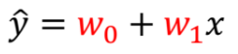
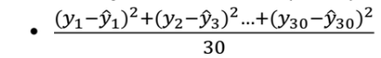
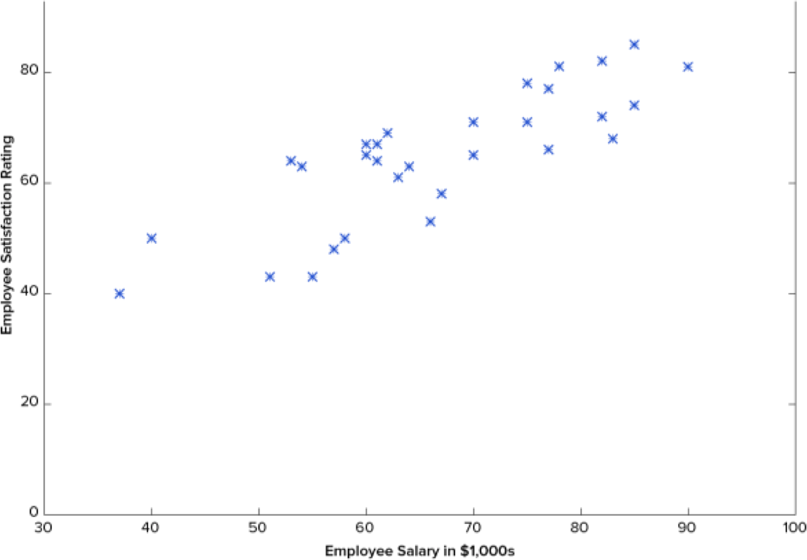
Simple Linear Regression Example
Regression Line
Measure
Mean Squared Error (MSE)
estimated value for $90,000
real value for $90,000
Employee | Salary | Satisfaction Rating (real) | Satisfaction Rating (predicted)
100 | 𝑥₁ | 𝑦₁ | 𝑦!₁
101 | 𝑥₊ | 𝑦₊ | 𝑦!₊
102 | 𝑥* | 𝑦* | 𝑦!*
… | … | …
130 | 𝑥₄ | ^{𝑦}*0 | 𝑦!_{*0}
real value for $70,000
estimated value for $70,000

Slide 13
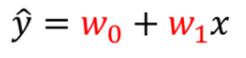
Simple Linear Regression Example
Regression Line
Try many guesses to minimize MSE and select the line that minimizes MSE.

Slide 14
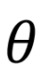
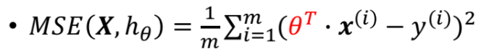
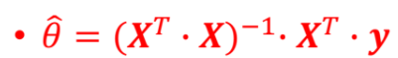
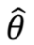
Finding the value of
Cost Function
Closed-form solution
A mathematical equation that gives the result directly.
Ordinary Least Squares (OLS, 최소자승법)
A method for estimating the unknown parameters in a linear regression model.
where is the value of that minimizes the
cost function and 𝑦 is the vector of target values
오차를 최소화하는 값을 찾자

Slide 15
Finding the value of
OLS : 가장 기본적인 결정론적 회귀 방법으로 잔차 제곱 합( RSS : Residual Sum of Squares) 를 최소화하는 가중치 벡터를 행렬 미분으로 구하는 방법이다.
최소제곱법( Least Square Method ) : 가장 적합한 회귀계수 추정치를 찾음으로써 가장 적합한 회귀 직선을 추정하는 것.
Computational complexity of OLS
Pros
The method is linear (𝑂(𝑚) ) with regards to the number of instances in the training set.
훈련 셋의 인스턴스에 대해 선형을 띈다.
Cons
The computational complexity of inverting 𝑋^{𝑇} ` 𝑋, which is a 𝑛×𝑛 matrix, is typically about 𝑂(𝑛^{2.4}) to 𝑂(𝑛³).
The method gets very slow when the number of features grows large (e.g., 100,000).
계산의 복잡도로 인한 연산 시간 증가.

Slide 16
Finding the value of
Gradient Descent (경사하강법)
An optimization algorithm for finding the minimum of a function.
비용 함수를 최소화하기 위해 매개변수를 반복적으로 조정합니다.
함수의 최소법을 찾기 위한 최적화 알고리즘)
The general idea
It tweaks parameters iteratively in order to minimize a cost function.
함수는 비용을 최소화 하기 위해 매개변수를 반복적으로 교정합니다.

Slide 17
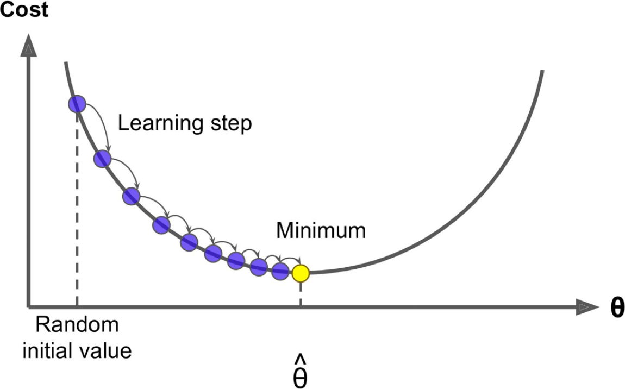
Gradient Descent(경사하강법)
Steps
Filling ! with random values (random initialization)(시작점 선택)
It measures the local gradient(slope) of the error function with regards to the parameter vector (손실 곡선의 기울기를 계산)
It goes in the direction of descending gradient. (기울기의 방향으로 이동)
Once the gradient is zero, you have reached a minimum. (기울기가 0이 되면 최소)

Slide 18
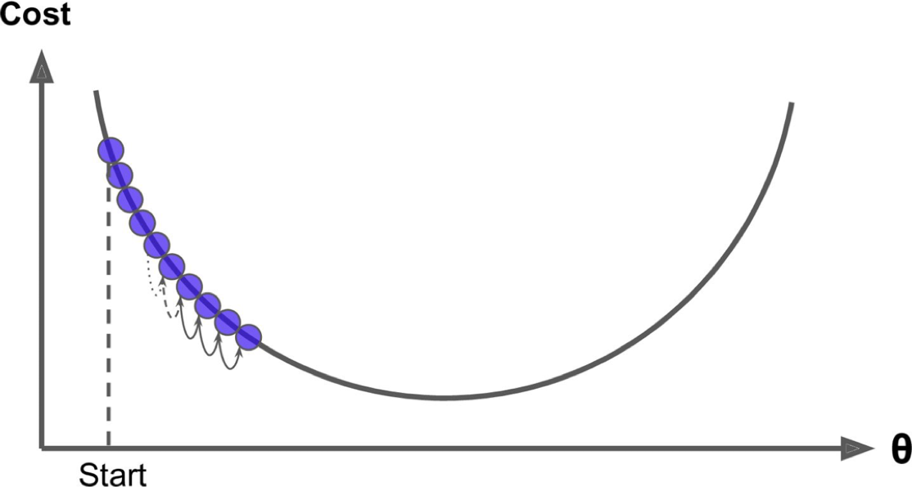
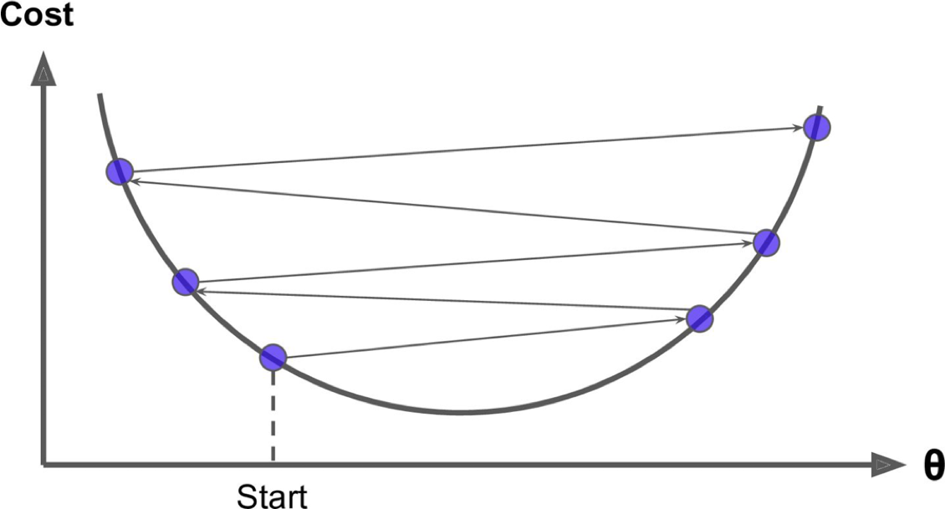
Gradient Descent
Learning Rate
The size of the steps.
스텝의 크기, 움직임의 정도
If too small, the algorithm have to go through many iterations to converge.
너무 작으면 수렴하기까지 반복 횟수기 많다(계산을 많이한다)
If too high, the algorithm may jump across the valley and end up on the other side.
너무 높으면, 값이 튄다

Slide 19
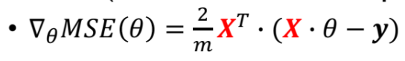
Gradient Descent
To implement gradient descent, we need to compute the gradient of the cost function with regards to each model parameter !_{j}.
경사하강법을 구현하려면 각 모델 매개변수에 대해 비용함수의 경사를 계산해야 한다.
How much the cost function will change if you change !_{j} just a little bit.
각 모델 매개변수를 약간 변화시킨다면, 비용함수는 얼마나 변화하는지.
The gradient vector contains all the partial derivatives (편미분) of the cost function (one for each model parameter)
기울기 벡터는 각 모델 파라미터에 대해 하나씩 비용함수의 모든 편미분을 포함합니다.
At each Gradient Descent step, calculations over the full training set are involved.
각 step 마다 전체 데이터에 대해 계산을 해야 함

Slide 20
Gradient Descent
Batch Gradient Descent
Uses the whole training set to compute the gradients at every step.
각 스텝마다 전체 학습 셋을 사용
Stochastic Gradient Descent
Picks a random instance in the training set at every step and compute the gradients based only on that single instance.
하나의 랜덤 인스턴스를 뽑아서 한스텝에 하나의 데이터만을 계산함.
Mini-batch Gradient Descent
Uses small random sets of instances called mini-batches.
미니배치라고 부르는 작은 랜덤 데이터 셋을 사용한다.

Slide 21
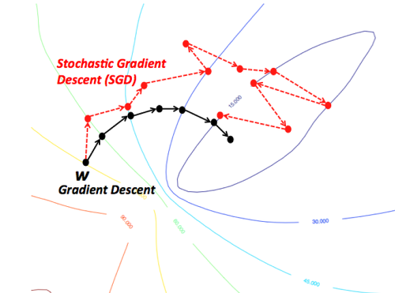
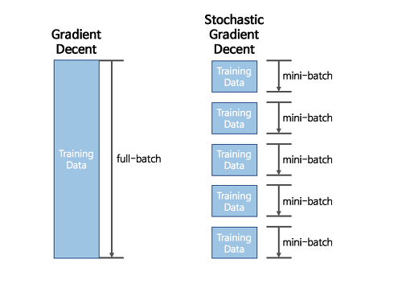
Gradient Descent
Batch Gradient Descent
Guaranteed to find the global minimum if the cost function is convex. If not, may end up with a local minimum.
Slow on large training sets.
Stochastic Gradient Descent
Fast even on large training sets.
The final parameter values are good, but not optimal.
When the cost function is irregular, it has better chance of finding the global minimum.
Mini-batch Gradient Descent (
Ends up walking around a bit closer to the minimum than SGD.
May be harder for it to escape from local minima than SGD.

Slide 22
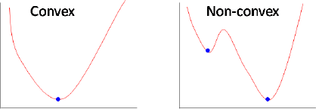
Convex Function
A function is convex if the line segment between any two points on the graph of the function lies above or on the graph.
Convex 란? 어떤 두 점을 찍어서 선으로 연결해도 그 사이 모든 점들은 다 그 안에 들어오도록 있는 경우

Slide 23
Gradient Descent for Linear Regression
MSE cost function for a Linear Regression model is a convex function.
선형회귀 모델에 대한 MSE 비용함수는 볼록함수다.
There is no local minima, just one global minimum.
It is a continuous function with a slope that never changes abruptly.
Theoretically, Gradient Descent is guaranteed to reach the global minimum in the MSE cost function for a Linear Regression.
선형회귀에서 MSE 비용함수는 전역최소값에 도달할 수 있다는 보장이 된다.
In practical, we approach close the global minimum with sufficient time and a reasonable learning rate.

Slide 24
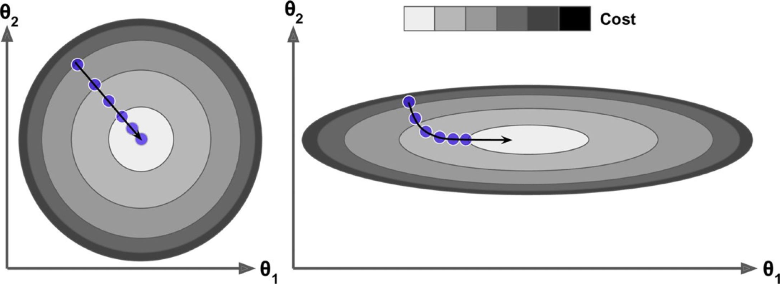
Gradient Descent for Linear Regression
The cost function for a Linear Regression model has the shape of a bowl.
Round bowl if the features have the same scale.
Elongated bowl(길쭉한 ) if the features have very different scales.
When using Gradient Descent, all features should have a similar scale.
모든 피쳐는 유사한 스케일을 가져야 한다.

Slide 25
Polynomial Regression

Slide 26
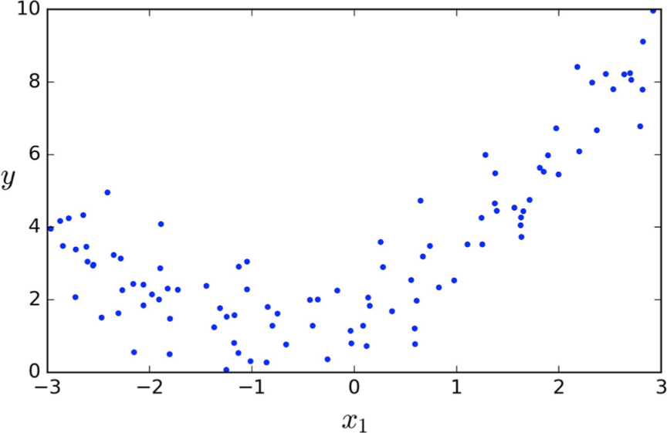
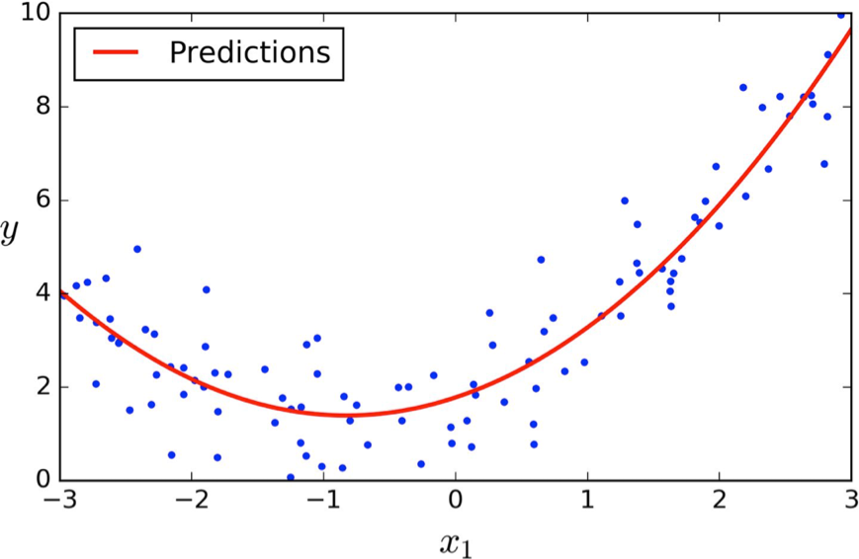
Polynomial Regression(다항회귀)
What if data are not linear?
Adding powers of each feature as new features, then train a linear model on this extended set of features.
각 피쳐의 제곱을 값으로 추가한 다음 이 집합에 대한 선형 모델을 훈련한다.

Slide 27
Polynomial Regression
Example
If two features 𝑥₁ and 𝑥₂
Adding the square (2nd-degree polynomial) of each feature in the training set,
𝑥₁, 𝑥₂, 𝑥₁𝑥₂, 𝑥₁², 𝑥₂², if also consider all combinations of features up to the given degree.
𝑥₁ | 𝑥₂ | y
𝑥₁ | 𝑥₂ | 𝑥₁𝑥₂ | _{𝑥1}2 | _{𝑥2}2 | y

Slide 28
Polynomial Regression
Polynomial regression is considered to be a special case of multiple linear regression.
𝑥₁ | 𝑥₂ | y
𝑥₁ | 𝑥₂ | 𝑥₁𝑥₂ | _{𝑥1}2 | _{𝑥2}2 | y

Slide 29
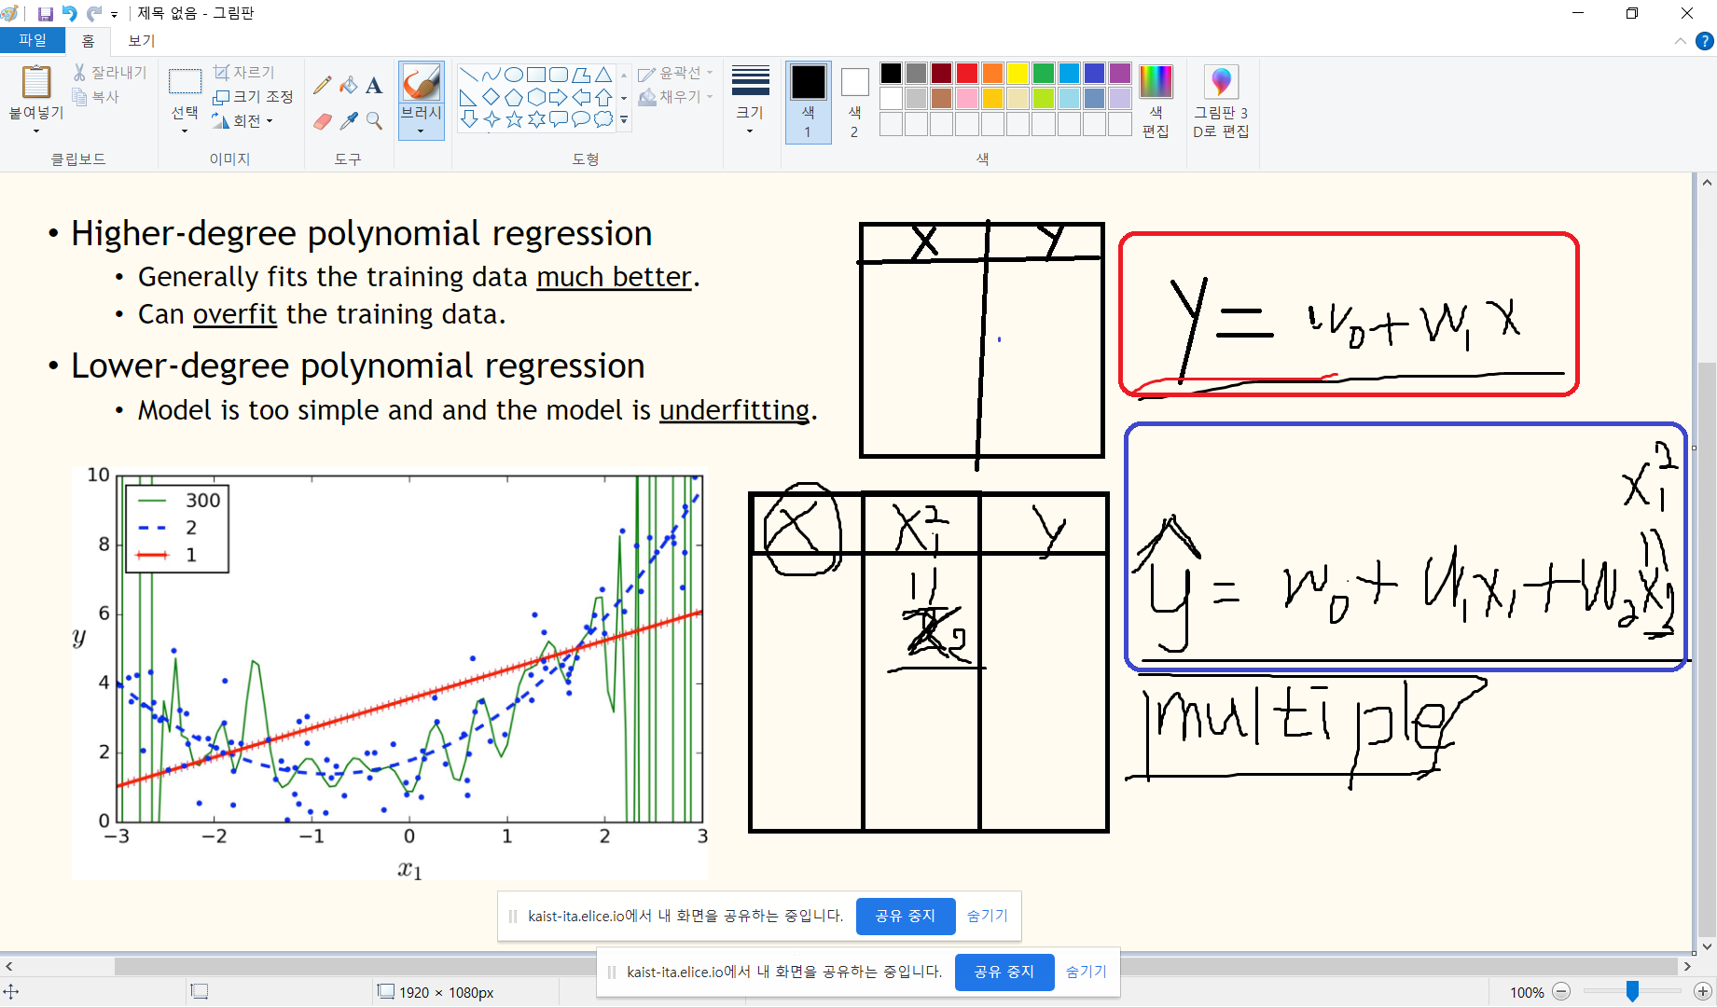
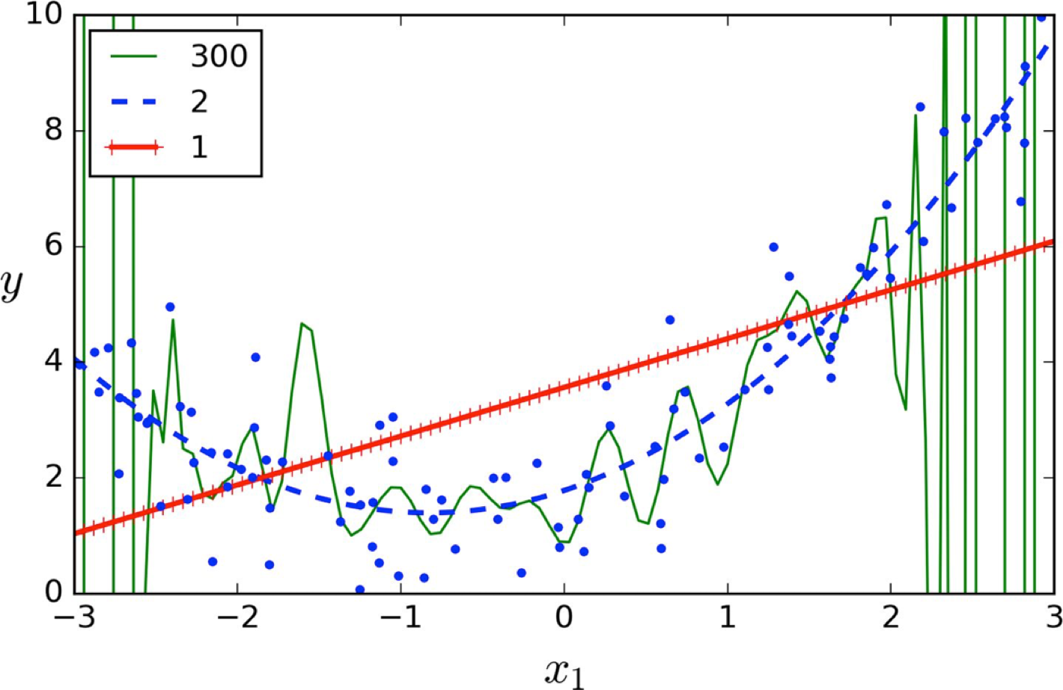
Polynomial Regression
Higher-degree polynomial regression
Generally fits the training data much better.
Can overfit the training data.
Lower-degree polynomial regression
Model is too simple and and the model is underfitting.

Slide 30
Regularized Linear Models

Slide 31
Regularization
A technique of reducing overfitting (과적합) .
Discourages learning a complex model. (복잡한 모델)
Improves the generalizability of a learned model.
모델의 일반화 성능을 높이는 방법론
augmentation,
Ensemble model
Dropout
Dropconnect
BatchNormalization
Early stopping
Weight decay
Multi-Task learning 등
L1, L2 Regularization
모델 학습 = weight matrix 를 좋은 방향으로 업데이트 하는것,
Weight 가 과도하게 커지면 특정 인풋들에 의존, 일반화 성능이 떨어짐.
L1, L2의 역할은 이 때 weight 가 너무 커지지 않도록 하는 것

Slide 32
Regularized Linear Models
(정규화 선형 회귀)
For a linear model, regularization is typically achieved by
constraining the weights of the model via a regularization term.
선형 모델의 경우 정규화는 일반적으로 정규화 항을 통해 모델의 가중치를 제한하여 달성됩니다.
A regularization term is only added to the cost function during training.
정규화 항은 훈련 중에 비용함수에만 추가됩니다
Once the model is trained, the model’s performance is evaluated using the unregularized performance measures.
모델이 훈련되면 정규화되지 않은 성능측정을 사용하여 모델의 성능을 평가합니다.

Slide 33
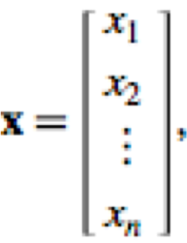
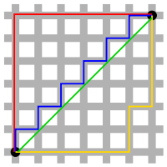
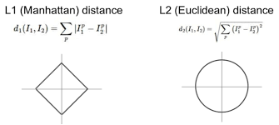
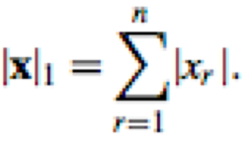

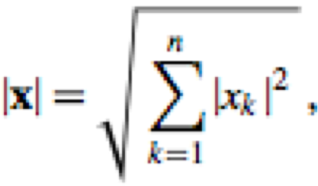
Norm
많은 Norm 중 하나가 절댓값.
The norm of a mathematical object is a quantity that describes the length, size, or extent of the object.
어떤 값의 크기를 계산하여, 비교가 가능하게끔 하는 것.
Vector Norm
L1-Norm (Mahattan Distance, Taxicab geometry)
L2-Norm (Euclidean Distance)
http://mathworld.wolfram.com/Norm.html

Slide 34
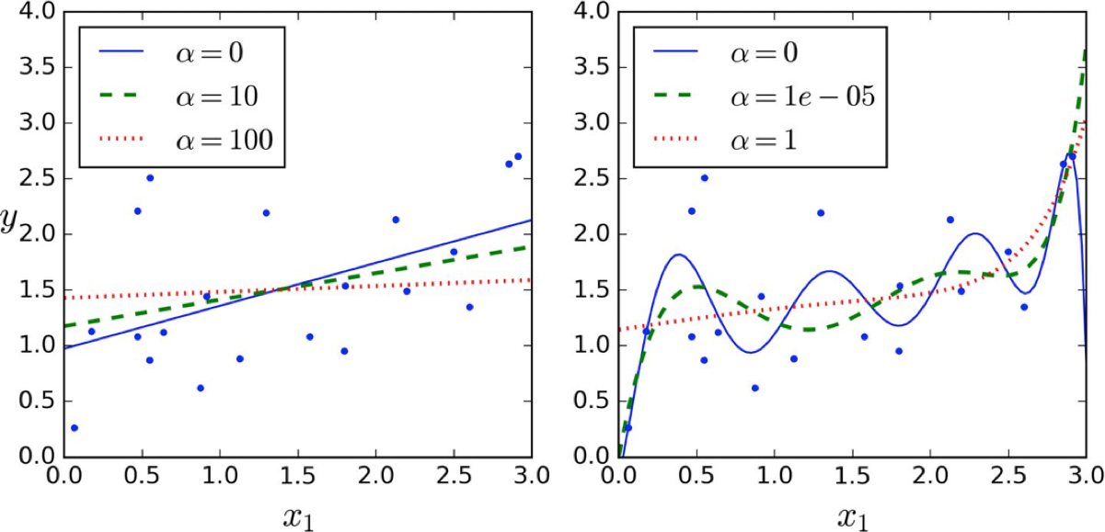
Ridge Regression
이 회귀 방법은 일반적으로 영향을 거의 미치지 않는 특성에 대하여 0에 가까운 가중치를 준다.
This forces the learning algorithm to not only fit the data but also keep the model weights as small as possible.
𝛼 controls how much to regularize the model
if 𝛼 = 0, Ridge Regression is just Linear Regression.
If 𝛼 is very large, then all weights end up very close to zero, leads to a flatter line.
Polynomial (degree=10)

Slide 35
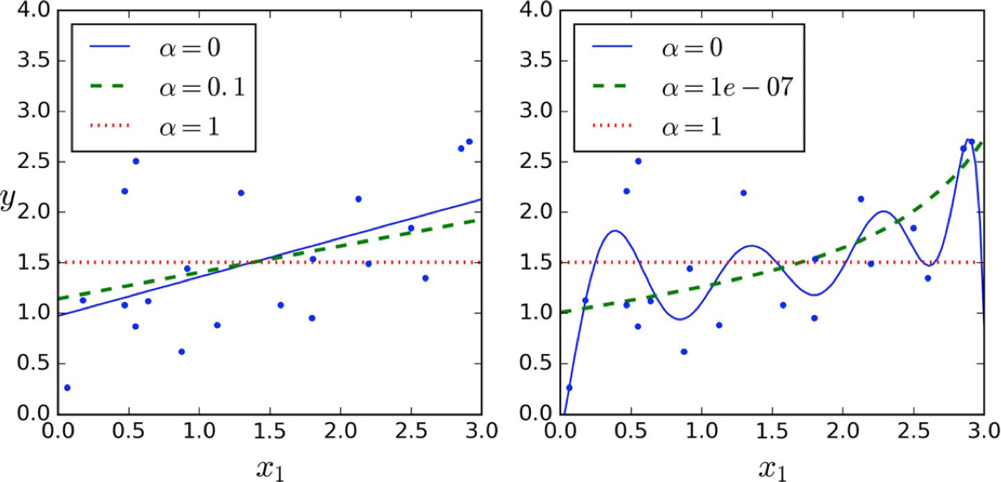
Lasso Regression
특정값의 계수가 매우 낮다면 0으로 수렴하게 하여 특성을 지워버린다. (bias 를 증가, overfitting 방지!)
Least Absolute Shrinkage and Selection Operator Regression
It tends to completely eliminate the weights of the least important features.
The dashed line looks quadratic.
Lasso Regression automatically performs feature selection and outputs a sparse model (i.e., model with few nonzero feature weights)
Polynomial (degree=10)

Slide 36
Elastic Net
엘라스틱 넷은 라쏘회귀와 릿지회귀의 최적화 지점이 서로 다르기 때문에 두 정규화 항을 합쳐서 r로 규제정도를 조절하여 준다
In Elastic Net , the regularization term is mix of both Ridge and Lasso Regression’s regularization terms with the mix ratio 𝑟.
When 𝑟 = 0, it is equivalent to Ridge Regression.
When 𝑟 = 1, it is equivalent to Lasso Regression.

Slide 37
Which one?
It is almost always preferable to have regularization and should avoid plain Linear Regression.
Ridge is default, but if you suspect that only a few features are actually useful, Lasso or Elastic Net should be used.
Elastic Net is preferred over Lasso
when the number of features is greater than the number of training instances.
when several features are strongly correlated.
보통의 선형회귀(규제 없는 모델)은 피할것 규제가 약간 있는 것이 좋음!
릿지가 기본적으로 사용되지만, 실제로 사용되는 특성이 몇 개 뿐이라고 의심되면 랏쏘나 엘라스틱넷 사용
이 모델들은 불필요한 특성 가중치를 0으로 만든다
특성 수가 훈련 샘플 수 보다 많거나 몇개가 강하게 연관되어 있을 때는 랏소가 문제 생길 수 도 있으므로 엘라스틱넷을 더 선호함

Slide 38
Logistic Regression

Slide 39
Logistic Regression
Logistic Regression (Logit Regression) is used to estimate the probability that an instance belong to a particular class.
로지스틱 회귀는 인스턴스가 특정 클래스에 속할 확률을 추정
If the estimated probability is greater than 50%→positive class
If the estimated probability is less than 50% →negative class
It is used in binary classification problem.
이진 분류 문제에 사용됩니다.
Like Linear Regression, it computes a weighted sum of the input features plus a bias term.
선형 회귀와 마찬가지로 입력 특성과 편향 항의 가중치 합을사용.

Slide 40
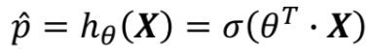
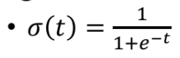
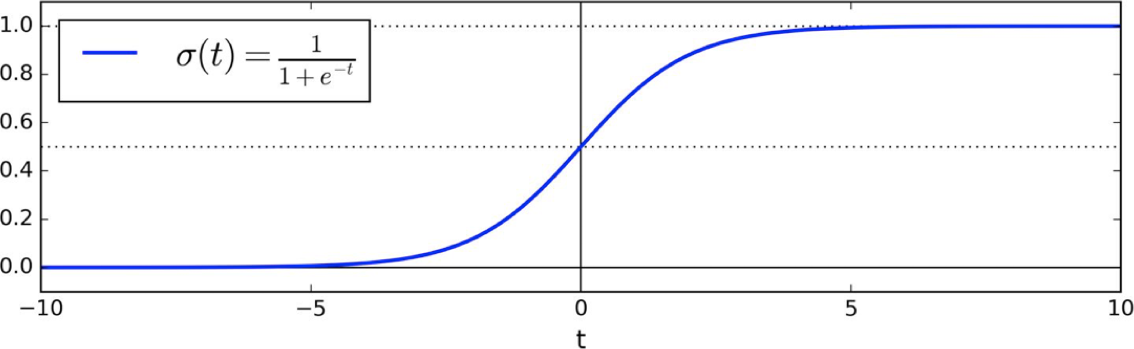
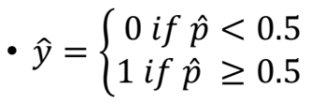
Logistic Regression
Equation
where 𝜎 is called logistic or logit, is a sigmoid function that outputs a number between 0 and 1.
Logistic function
Prediction

Slide 41
Logistic Regression
Training
The objective is to make the model estimates
High probabilities of positive instances (y=1) (긍정 인스턴스의 높은 확률)
Low probabilities for negative instances (y=0) (부정 인스턴스의 낮은 확률)
Cost function
The cost should be large if the model estimates a probability close to 0 for a positive instance.
모델이 긍정적인 인스턴스에 대해 0에 가까운 확률을 추정하는 경우 비용이 커야 한다
The cost should also be large if the model estimates a probability close to 1 for a negative instance.
모델이 음수 인스턴스에 대해 1에 가까운 확률을 추정하는 경우 비용도 커야 한다.

Slide 42
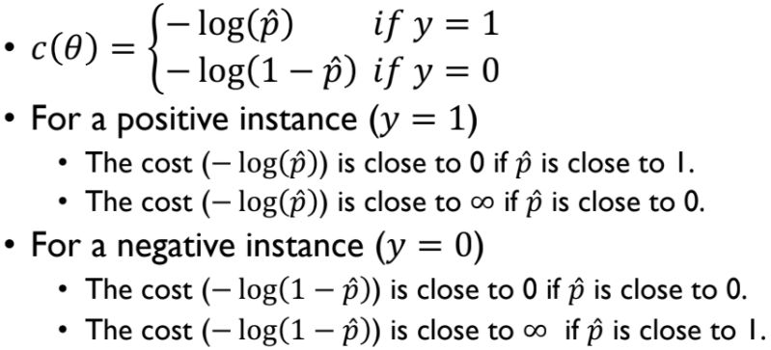
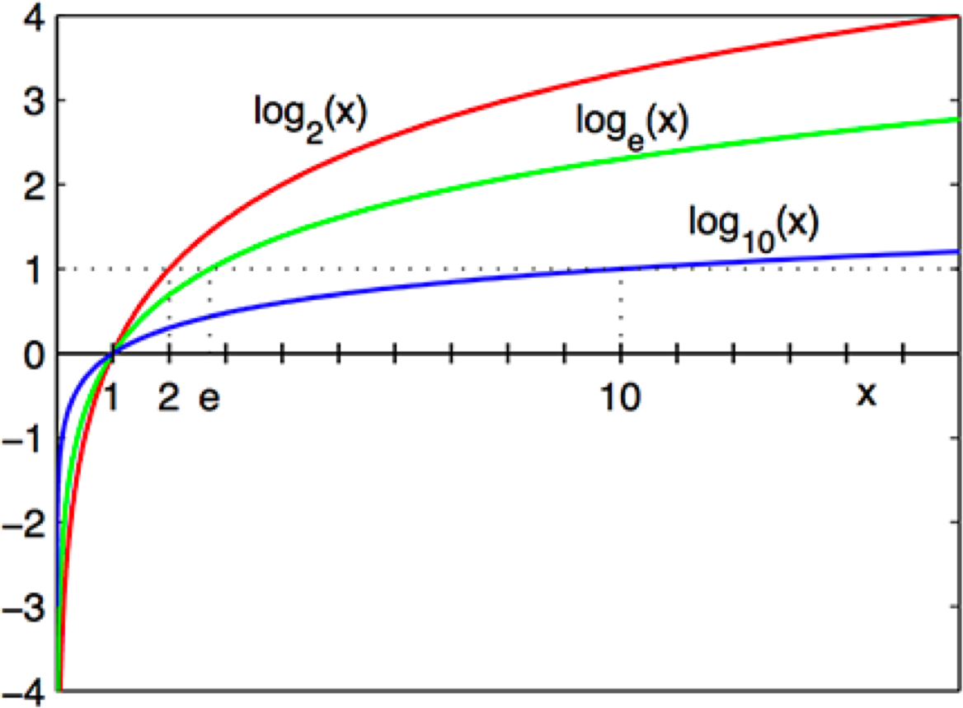
Logistic Regression
Cost function (a single training instance)

Slide 43
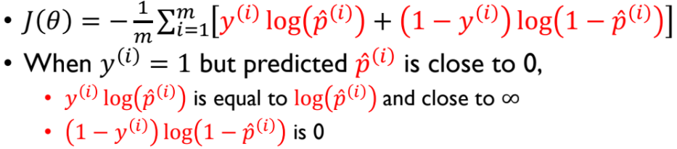
Logistic Regression
Cost function (log loss)
No known closed-form equation.
The cost function is convex, Gradient Descent is guaranteed to find the global minimum.
비용함수는 볼록한 형태로, 경사하강법은 전역 최소를 찾는것이 보장된다.

Slide 44
Multinomial Logistic Regression
(다중 로지스틱 회귀분석)
Multinomial Logistic Regression이란 y의 범주가 3개 이상(multi)이며 명목형(nomial)일 때 사용하는 로지스틱 회귀분석이다.
Multinomial Logistic Regression (Softmax Regression) is a classification method that generalizes logistic regression to multiclass problems.
The general idea
For a given instance, it computes a score for each class.
주어진 인스턴스에 대해, 각 클래스의 점수를 계산
Then, estimates the probability of each class by applying the softmax function to the scores.
Softmax 함수를 적용하여 각 클래스의 확률을 추정

Slide 45
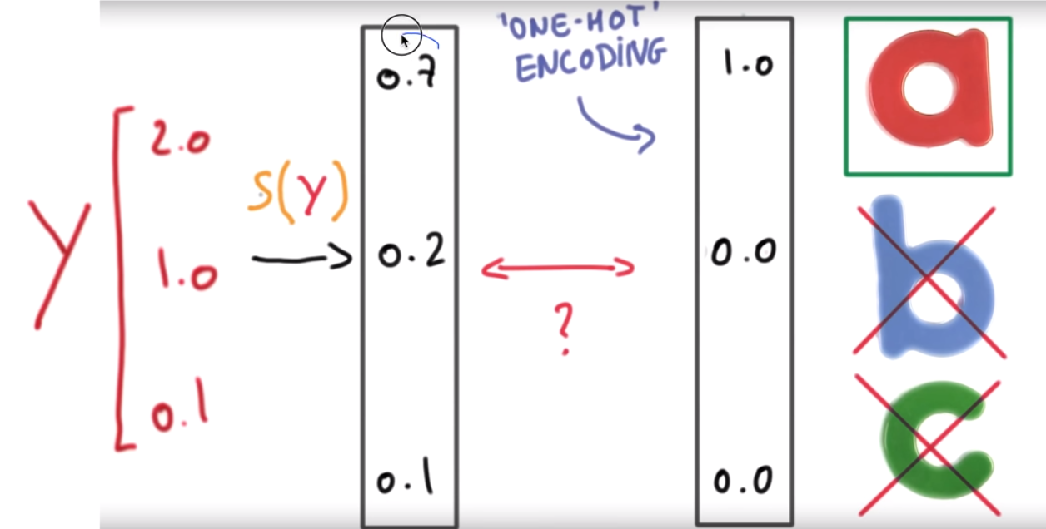
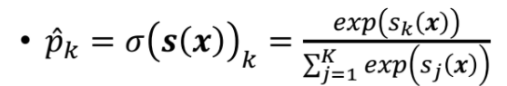
Multinomial Logistic Regression
Softmax score for class k
Softmax function
𝐾 is the number of classes
𝑠 ( 𝗑) is a vector containing the scores of each class for the instance 𝗑
𝜎 (𝑠 (𝗑_{𝑘})) is the estimated probability that the instance 𝗑 belongs to the class 𝑘.
It predicts the class with the highest estimated probability.
필요하다면 뒤에 one-hot encoding 을 통해 하나만 뽑을 수 있다. (뒷장)

Slide 46
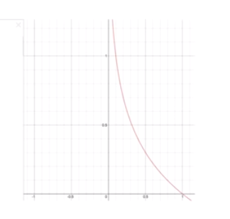
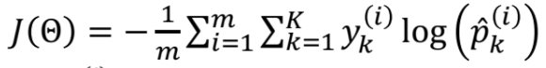
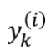
Multinomial Logistic Regression
Cost function (cross entropy)
is equal to 1 if the target class for the i^{𝑡h}instances is 𝑘; otherwise, it is equal to 0.
When there are two classes, it is equivalent to log loss.
목적 : 실제값과 예측값이 일치하면 cost 를 작게, 일치하지 않으면 크게 만드는 것

Slide 47
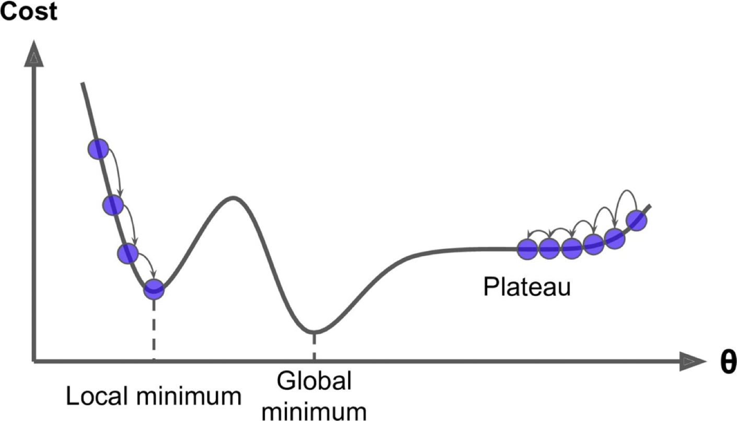
Gradient Descent
Challenges
If the random initialization starts the algorithm on the left, it will converge to a local minimum.
랜덤 초기값이 왼쪽에서 시작한다면 local minimum 에 빠지고
If it starts on the right, it will take a very long time to cross the plateau.
오른쪽에서 시작한다면너무 평평한 곳을 너무 오래 지나야 한다.

